Slide 1
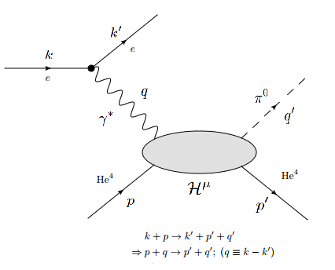
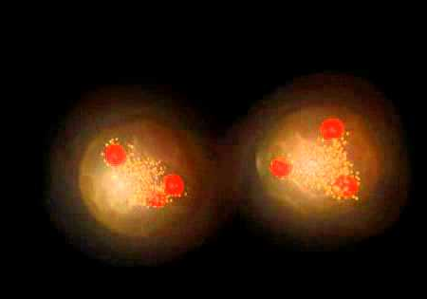
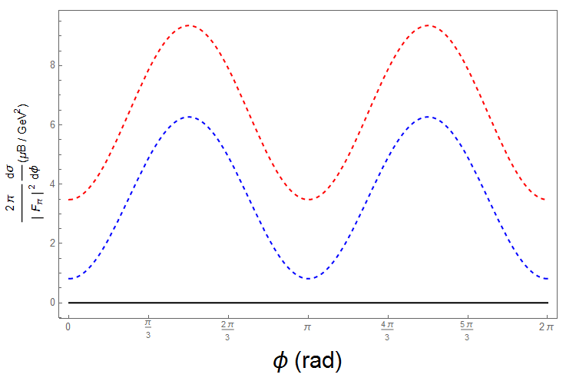
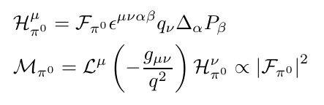
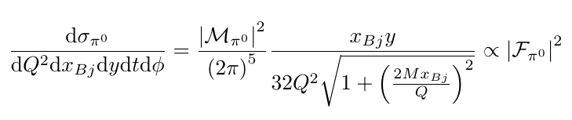
DEPARTMENT OF PHYSICS
Extracting Form Factors of Hadronic Structures Model-Independently
C. R. Ji, A. Lundeen
Research Goals
Extract information about hadronic structure contained in so-called Form Factors by creating model-independent predictions
Illustrate the benefits of the model-independent formulation, especially at high beam energies
Research Value
Able to analyze even complicated targets – no perturbative QFT approximations
Experimentally testable
Challenges conventional models that we believe may lose validity in high beam energy regimes
One of the primary interactions we investigate: the collision of a high energy electron with a scalar (spinless) target (Helium-4, for instance). We can compute the probability that the target doesn’t split and a scalar particle is produced.
Future Research
Apply methods to targets with spin
Consider more general cases and reactions
Step 1 – Compute Amplitude in terms of Form Factors and 4-momenta
Step 2 – Compute differential cross section in terms of invariant quantities
Step 3 – Get numerical predictions that can be tested experimentally

